Slide 1
Predicting Presidential Approval
Andrew Touchet, Philip Raeisghasem

Slide 2
Overview
Introduction and Motivation
Problem Statement
Data Sources
Regression Analysis
Numerical Results

Slide 3




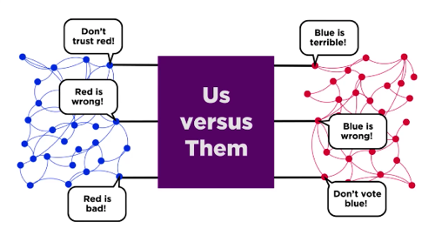
Significance of Presidential Approval
Forecast Elections
Projection of Presidential Responsibility
Quantify political divide

Slide 4
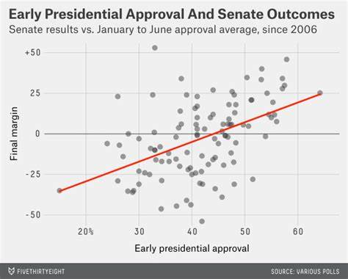
Problem Statement
Regression to study factors’ effect on public opinion Magnitude, sign, and variance Economic & Public Opinion & Twitter
Analysis Interpreting β Forecasting Outliers
https://fivethirtyeight.com/features/early-senate-polls-have-plenty-to-tell-us-about-november/

Slide 5
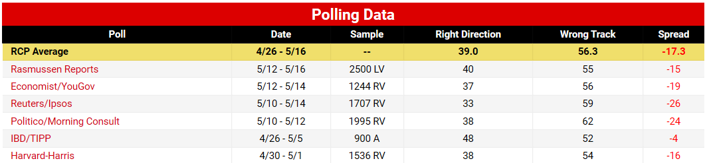
Data Sources
Response
Presidential Job Approval¹
Regressors
Direction of the Country²
Unemployment³
S&P 500⁴
Tweets^{5,6}
Required preprocessing
1 https://www.realclearpolitics.com/epolls/other/president_trump_job_approval-6179.html#polls
2 https://www.realclearpolitics.com/epolls/other/direction_of_country-902.html
3 https://fred.stlouisfed.org/series/CCSA?fbclid=IwAR0VLW9UPV54wG8UDfspAVHG_YjzadU0yQhSFn-arCKcKXer6Tavok3F7lg
4 https://finance.yahoo.com/quote/%5EGSPC/history
5 http://trumptwitterarchive.com/
6 https://www.kaggle.com/shaharz/classifying-tweets-of-trump-and-obama

Slide 6
Date Right Wrong
4/30 38 54
5/1 38 54
Date Right Wrong
4/28 48 52
4/29 48 52
4/30 38 54
5/1 38 54
….. ….. …..
5/5 38 54
40.5 53.5
Average polls in same week

Slide 7
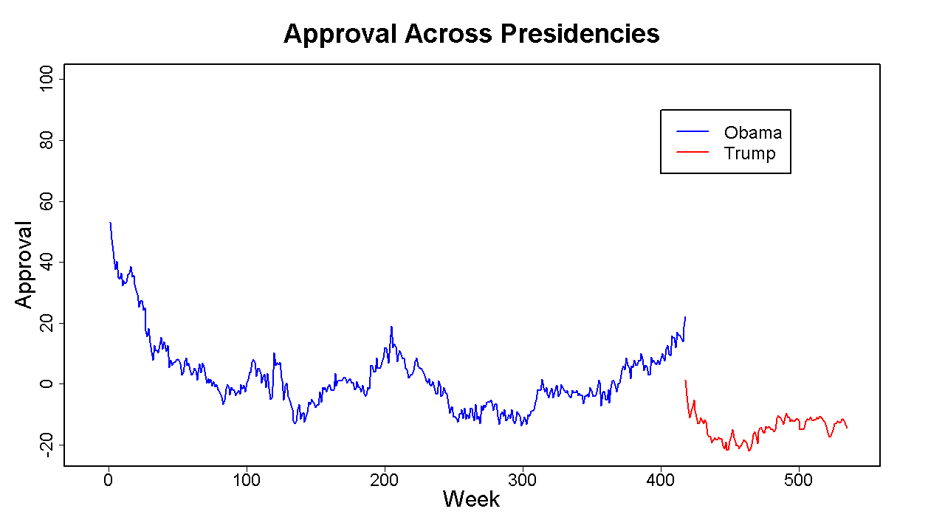

Slide 8
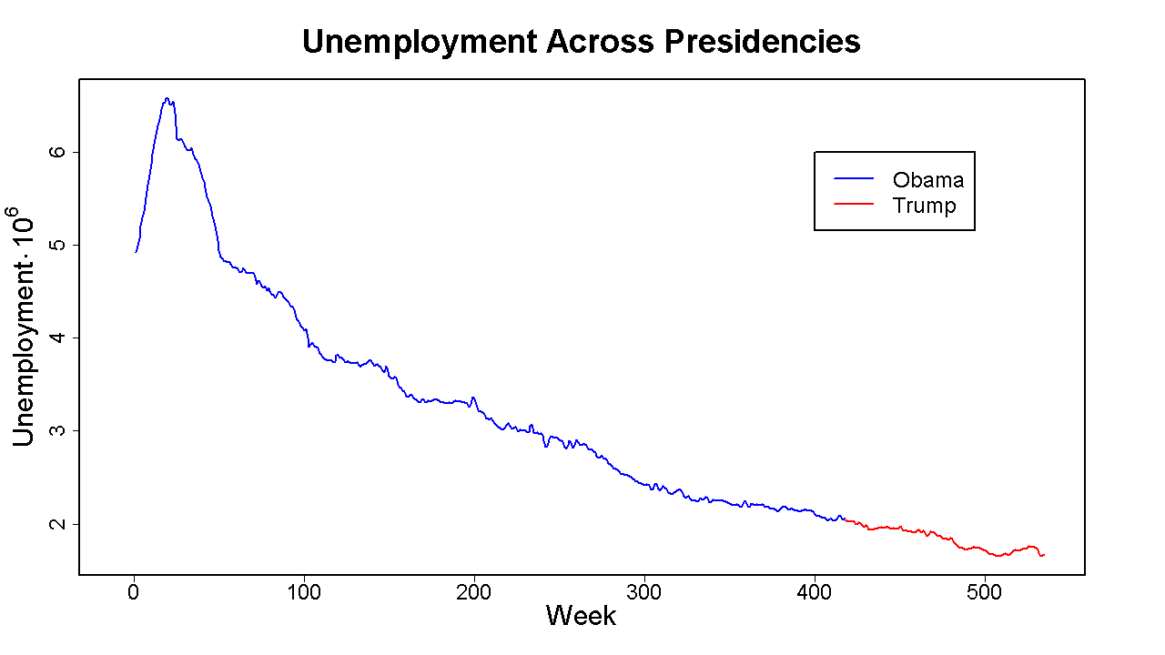

Slide 9
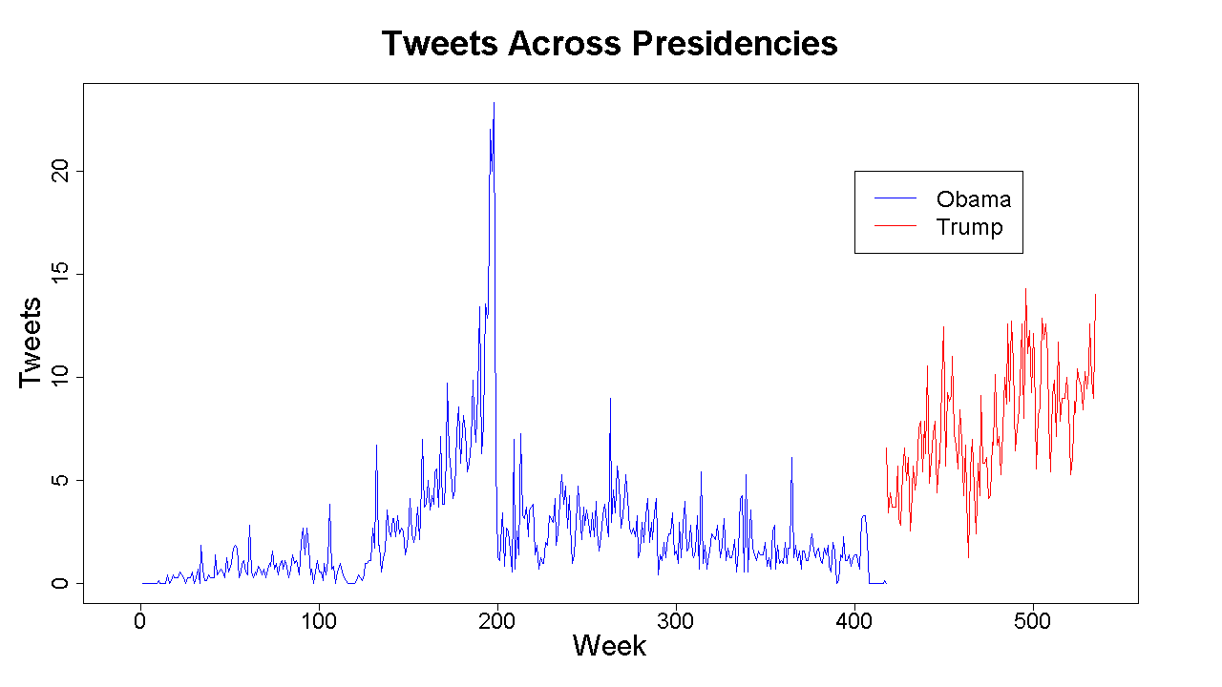

Slide 10
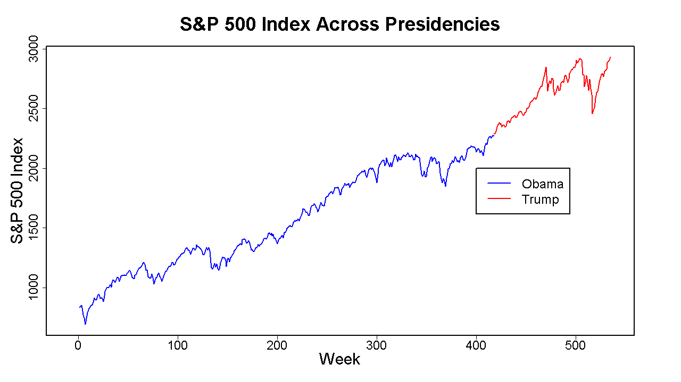

Slide 11
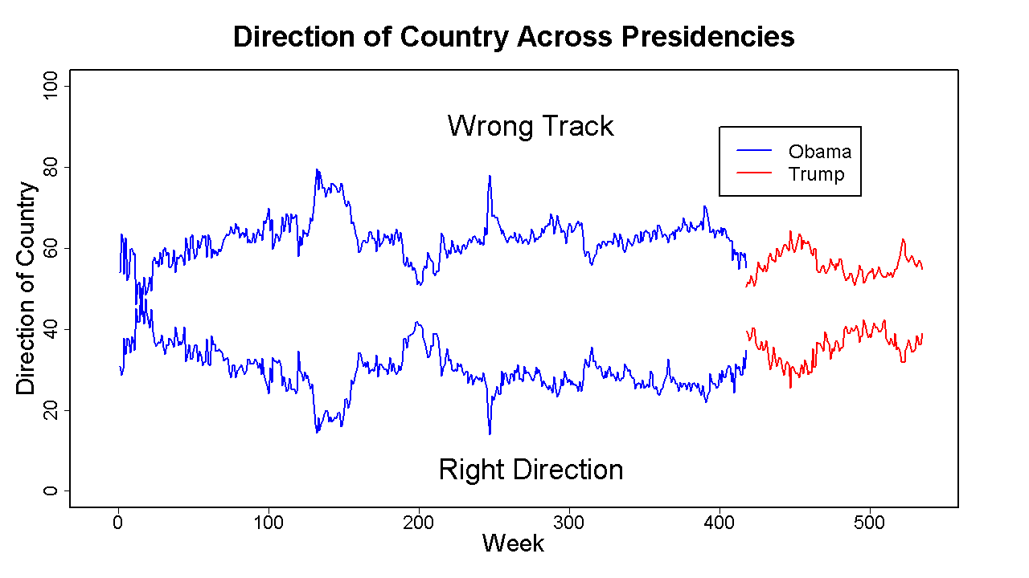

Slide 12
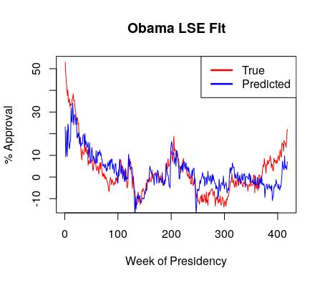
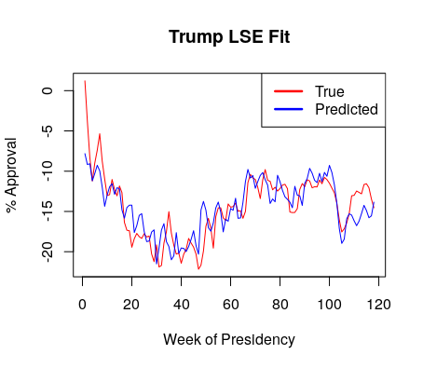
Regression Analysis - Initial Fit

Slide 13
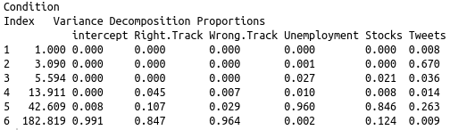
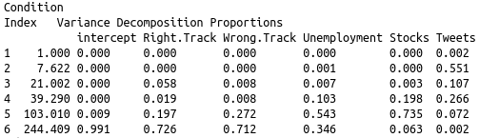
Regression Analysis - Multicollinearity
Obama
Trump

Slide 14
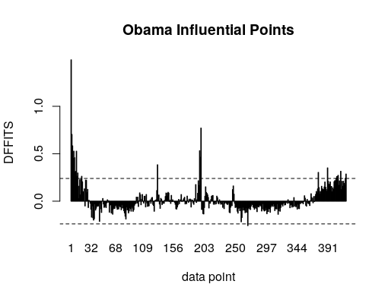
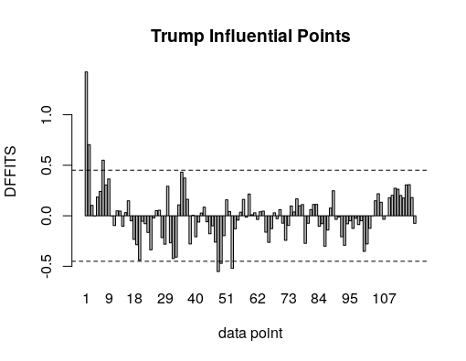
Regression Analysis - Outliers

Slide 15
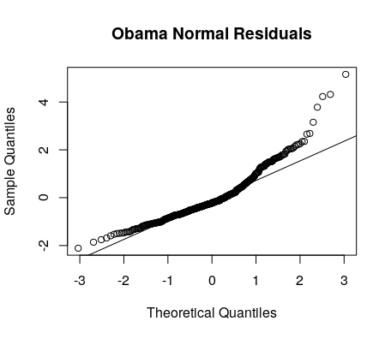
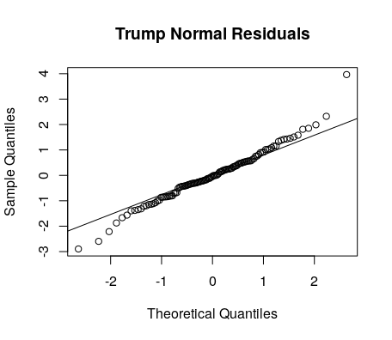
Regression Analysis - Residuals

Slide 16
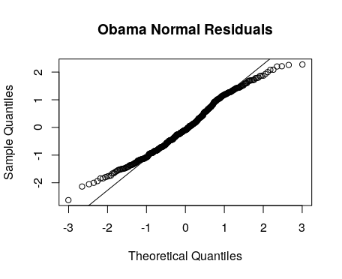
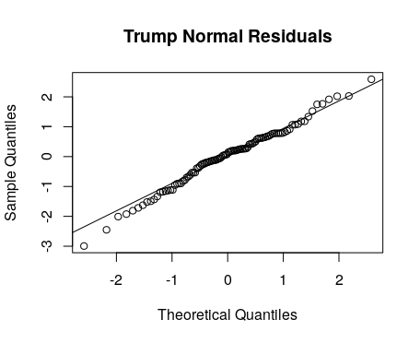
Regression Analysis - Residuals

Slide 17
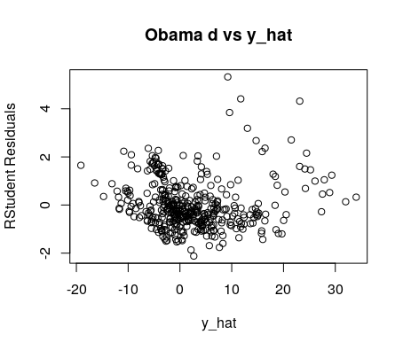
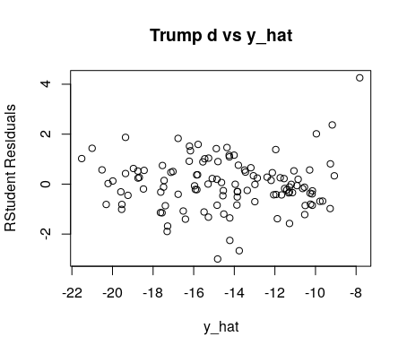
Regression Analysis - Residuals

Slide 18
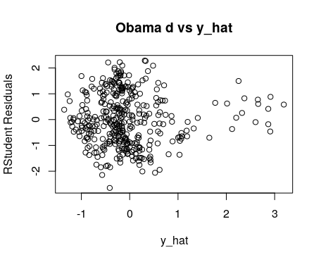
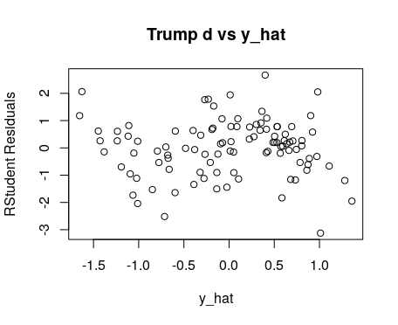
Regression Analysis - Residuals

Slide 19


Regression Analysis - Transformations
Box-Cox:
Box-Tidwell:
Both either diverged or gave no improvement.

Slide 20
Regression Analysis - Variable Selection
Checked all combinations of linear and squared principal components (no interactions)
Minimized prediction error from cross validation
Restricted search to fits with all significant coefficients

Slide 21


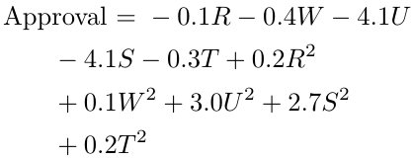
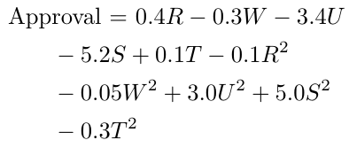
Numerical Results
Obama
7 principal components
Trump
4 principal components

Slide 22
Summary
Methods
PCA
Outlier Removal
Model Selection with Cross Validation
Problems
Autocorrelation
High variance
Possible Solutions
Higher-order autogression
More data

